Slide 1
Educational Details Data Analysis using Power BI

Slide 2
Introduction / Overview:
This project focuses on collecting and analysing Educational Details data of students.
The data was cleaned , structured and transformed to ensure accuracy before being imported into Power BI.
Using Power BI, dashboards and visual such as pie chart, donut chart, bar chart and etc.,
This analysis helps in understand student background (institute name ,their interest in extra circular activities etc.,)and learning preferences.

Slide 3
Tools Used:
Google Form – for collecting data
Excel – for data cleaning & preprocessing
Power BI – for data analysing & visualization

Slide 4
Objectives of the Project:
To load and clean the educational dataset
To create meaning visualizations in Power BI
To analyse student learning preferences and interests
To support decision-making using insights

Slide 5
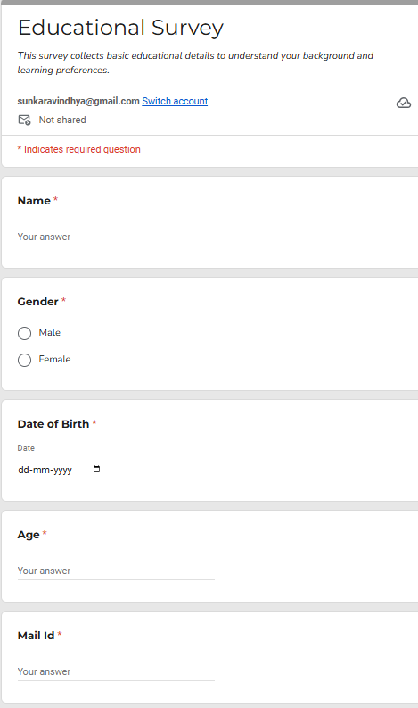
Dataset Description:
Fields/columns
Student name
Gender
Date of birth
Age
Mail id
Mobile number
District
Qualification
Stream
Institute name
Year of study
Total Number of Records: 153
Preferred learning style
Extracurricular activities
Academic performance

Slide 6
Data Cleaning & Transformation:
Removed missing values
Deleted duplicates
Corrected data types
Renamed and structured columns properly
Loaded data into Power BI model

Slide 7
Power BI Visuals Used:
Bar chart
Pie chart
Donut chart
Column chart
Filters/slicers
Cards

Slide 8
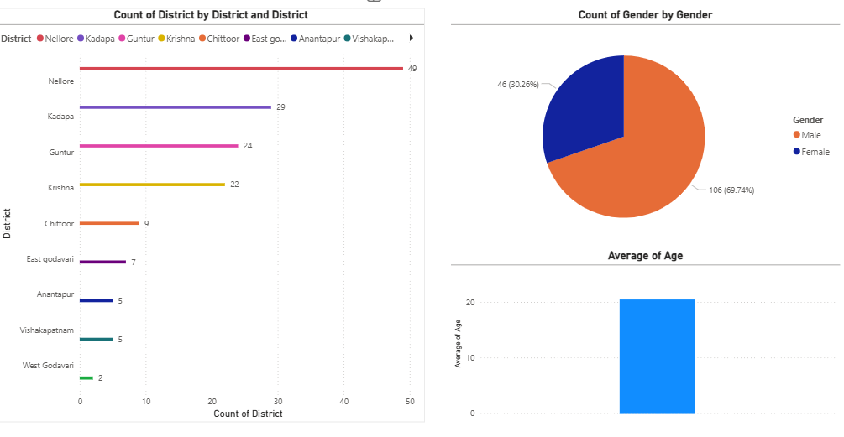
Dashboard 1- Demographic Analysis:
Gender distribution (pie chart)
City/District wise student count (Bar chart)
Age (Bar chart)

Slide 9
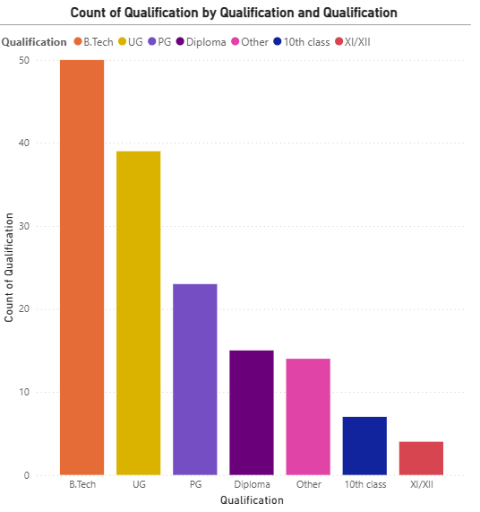
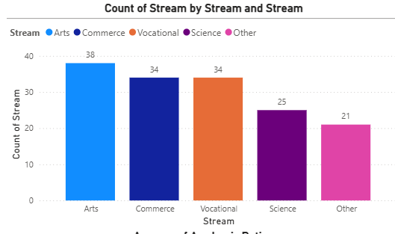
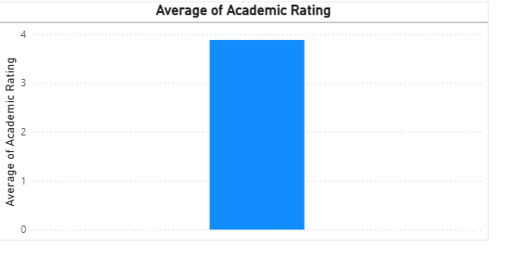
Dashboard 2 – Academic Analysis:
Academic Qualification
Stream wise number of students
Academic performances

Slide 10
Insights & Findings:
Female students account for 30.36% of total
Male students account for 69.64% of total
Majority of students belong to the age group 19 – 20
Highest academic performance in the range of 4 – 4.5 rating
Majority of students are from the district of Nellore
Majority of the students are pursuing B.Tech , showing strong interest in engineering programs
Very few students belong to other qualifications like Diploma , Degree & PG
Majority of the students are studying in their 3rd year

Slide 11
Conclusion:
The Educational Details dataset was successfully analyzed using Power BI, providing a clear understanding of student demographics and academic trends.
Interactive dashboards made it easier to study gender, age, qualification, and year-wise distribution of students.
Analysis showed that most students are pursuing B.Tech and a large portion are in their 3rd year, helping identify the dominant academic group
The project demonstrates how Power BI can convert raw data into meaningful insights that support decision-making in educational environments

Slide 12
Thank you
-Sunkara Vindhya

